Slide 1

Project 3 Proposal Vice City
David Sarker, Austin Jones, Greg Daly, Mike Kwon
March 4th, 2016

Slide 2

Table of Contents
Project Objective
Target Persona
Research & Analysis
Proposal
Next Steps

Slide 3
Project Objective
Create an Android Mobile App for Vice Media to consolidate
all Vice content into a centralized location for their readers

Slide 4

Vice User Persona
Name: Craig Sharker
Bio: 27 year old, single male living in Williamsburg, Brooklyn; currently unemployed, but going back to school to study graphic design
Interests: Enjoys indie music, going out in the West Village for late night drinks and recreational drug use
Goals: Make more money to support himself in an increasingly expensive neighborhood, without compromising his integrity by working for the man

Slide 5
Research & Analysis
Methodology:
Conduct qualitative research with current Vice Reader demographic via standardized interview questions, to identify common pain-points and key mobile behaviors
Key Findings:
Research revealed that majority of Vice Reader cohort splits media consumption between a variety of apps and their device’s default browser
Vice’s current mobile strategy exacerbates this by offering content across multiple applications
Browser was favored due to flexibility in switching between sites quickly and easily to find relevant content (vs. extra steps required to launch different apps)
Conclusion:
Consolidating Vice’s content from multiple apps into a single app and reducing the required clicks to content can increase user engagement with Vice properties

Slide 6
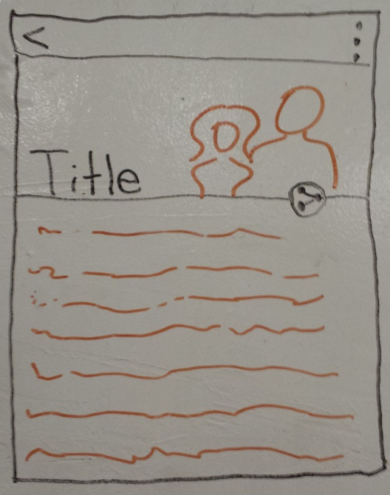
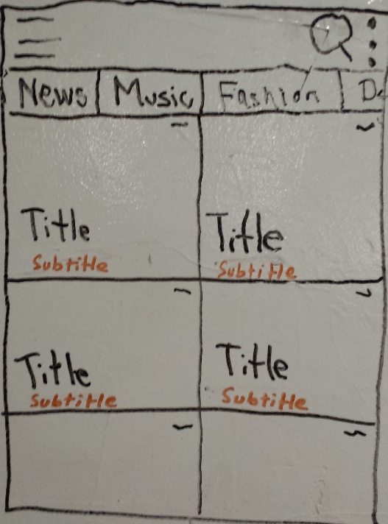
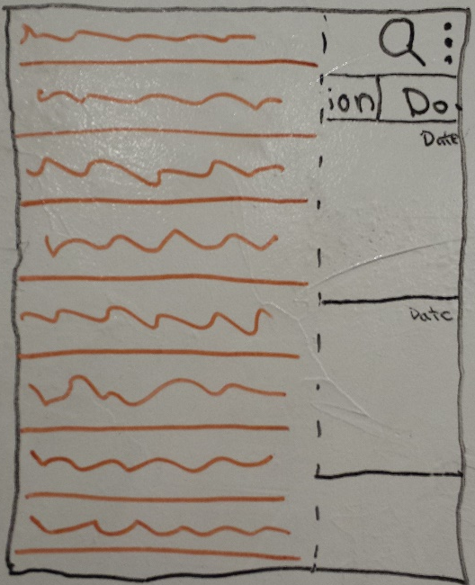
Proposal
Create a UI with intuitive navigation that allows Users to quickly & easily browse Vice’s rich collection of content, and minimize the effort required to find content that’s personally relevant
1-CLICK TO CONTENT

Slide 7
Proposal (cont…)
Hamburger menu launches drawer to access other Vice Properties
Settings can request notifications for new story alerts for a specific tag
Search functionality allows keyword searches for currently displayed content
Home Screen is populated with cards containing news stories
Scrollable tabs allow filtering by category within the currently selected Vice brand
Each card links to a single story launched in a new screen (so it takes one click to reach content)

Slide 8
Proposal (cont…)
Drawer lists all of Vice’s properties (Vice, Vice News, Vice Magazine, ViceLand), so user can navigate to their content without exiting the app
Clicking each list item will result in the home screen updating it’s tabs and associated cards (representing individual stories)

Slide 9
Proposal (cont…)
Home Navigation quickly takes user back to the Home Screen to continue browsing articles
When available, all news stories will start with rich media content
Sharing via Social Media will be prominently displayed to encourage viral potency of stories
Content will be scrollable to allow for long-form content that’s tailored by the journalist

Slide 10
Next Steps
Week 1 Deliverable:
Our team proposes delivering a Proof-Of-Concept by next Friday (3/11) to help illustrate our vision
Constraints:
Delivering a proof-of-concept by Friday will force us to focus mostly on ensuring base requirements are functional
Making sure Greg Daly stays sober this weekend
Stretch Goals:
Included fluid animations for article transitions (ex: FlipBoard)
Incorporate potential article reader audio support for commuters who can only listen to their news (driving, biking, etc.)
Incorporate Social Media integration to increase viral potency of articles

Slide 11
APPENDIX

Slide 12
Research Plan
Research Goals: Identify the most preferred way users like to access news content on their mobile devices
Research Questions:
How do target users get their news?
Do they visit news applications on their mobile devices?
Do users share the news with their friends?
What news do the target users’ view most?
What do users like/dislike about viewing news on mobile devices?
Methodology: Team members will use the below script to interview people about their opinions of their previous experiences with obtaining news using their mobile devices.
Participants: Millennials seeking news outside mainstream media (strong focus on subcultures & alternative scenes)
Interview Script:
In what formats (paper, mobile, website) do you access your news, and how frequently for each?
Do you read news on your mobile device? How frequently do you access it and how long do you spend each time?
Where do you typically read the news (home, subway, park, etc.) on your mobile device?
Do you have a favorite news app? If yes, why is it your favorite?
Is there a feature that you would like added to that app?
What news do you want to see the most on your mobile device?
Do you share news on your mobile device? If you do, how do you share it?

Slide 13
Research Results
VICE Mobile Competitive Analysis
Competitor | Graphical-Oriented Interface | Push Notifications | Twitter/FB Integration | Search Filter by Category & Tag | Supports Multiple Layouts
AP | Yes, the entire homescreen is split into cards that take up all screen space... This is a very strong model for using graphics to drive user attention. | Push notifications for breaking news stories only | Yes, there is a share button in the Actionbar of each article, with a fairly straightforward interface for editing the post prior to sharing | The homescreen has a TabLayout that is organized by news category. Within each category, there is a search function in the actionbar that searches by keyword. | The application only supports portrait layout
NPR | None. All text based. | Audio Player as Noticifation for newscasts | Able to share on all major social media and to other apps. | Able to search but no way to filter by category. | You are able to view the app in both portrait and landscape.
Politico | Images next to text inside of cards on the home screen | Sends push notifications as political news is happening. | Includes sharing through social medial and other apps | Can search and view content by category | You are able to view the app in both portrait and landscape.
FlipBoard | Large images that attract the user with minimal words | Allows notifications for breaking news, likes, mentions, friend activity, etc. | Includes sharing through social medial and other apps | Able to search and filter by sources, people, topics, etc. | Able to view articles in portrait and landscape
Buzzfeed | Mostly text bases with images for certain articles | No. | Yes. | With the alert stream tab on top you can use check boxs to filter. | No, the app sucks.

Slide 14
Research Results
User Stories:
As a user, I can view a list of current news stories
As a user, I can filter stories by section (e.g. News, Music, etc.)
As a user, I can search for stories using keywords
As a user, I can press a button to take me back to the home screen from the story screen
As a user, I can share stories via twitter and Facebook
As a user, I can press a button that extends a list of different Vice properties (e.g. Vice, Vice News, etc.) and navigate to that property’s content without exiting the app
As a user, I can refresh the content to get the most current articles

